Slide 1
Managing Budgets in Intacct
Kristin Jeffcoat, Project Manager
April 1, 2015

Slide 2
Objectives
This session will cover the following topics:
Understand how to create, view and modify reporting periods
Understand how to create, view and modify budgets
Include budget columns in financial reports
Project Accounting and IGC Budget Considerations

Slide 3
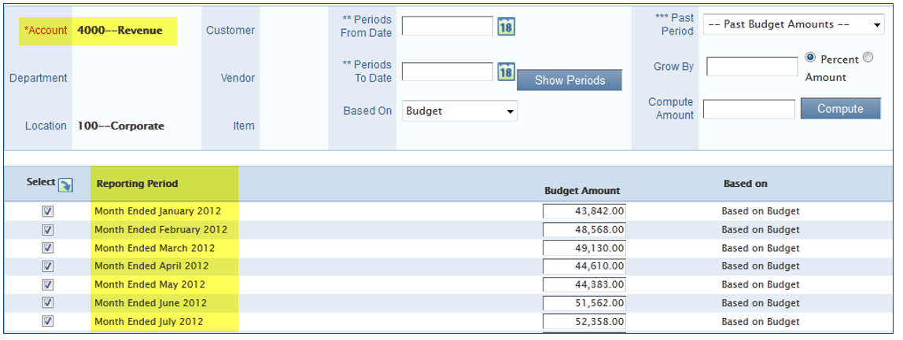
Creating Budgets – Requirements/Prerequisites
Reporting periods must exist and must be marked as Budgetable
  Budgetable periods are typically each month
  Budgetable reporting periods cannot overlap
Budget Ledger ID must be setup
Accounts used in the budget must exist in the Chart of Accounts
Dimensions are not required, but can only be included if they have been set up

Slide 4
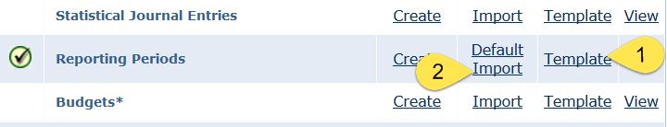
1 - Create Reporting Periods
Reporting Periods can be imported or manually created
Used for mapping Budget amounts to periods/months
Download and populate template, then import
  Company > Company Setup Checklist > Set Up General Ledger Transactions > Reporting Periods
Notes:
You can import additional reporting periods to account for time beyond the default periods. This is an implementation best practice and is a two-step process whereby you load the template with relevant reporting period information and then import the information from the .CSV file.

Slide 5
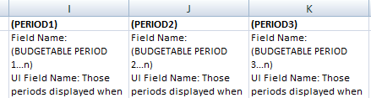
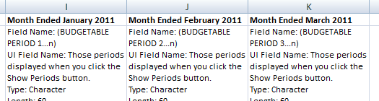
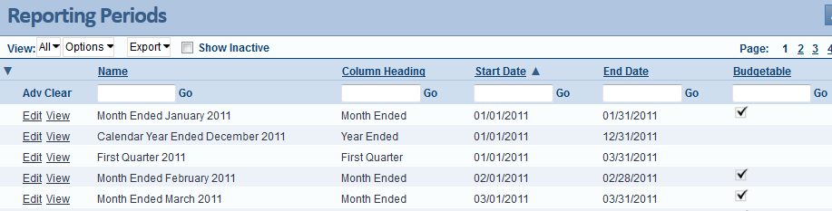

1 - Create Reporting Periods
Replace Period headers with actual period names
  Find reporting periods at Company > Reporting Periods
Period must be “budgetable”

Slide 6
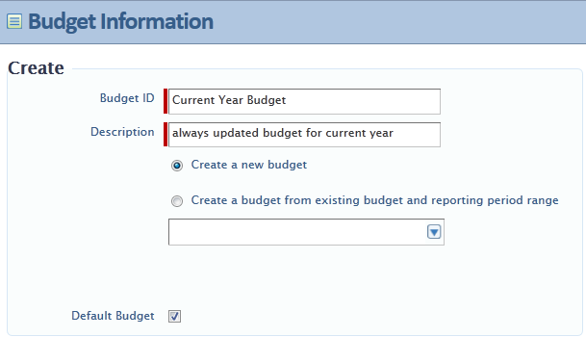
2 - Create Budget Ledger ID
Maintain budgets for use on financial reports
  General Ledger > Budgets
Notes:
On the Budget Information screen enter a Budget ID and Description (both are required). You may then select whether you want to create the budget from scratch, or whether you want to create the new budget based on existing budget data from another budget. To create a new budget from scratch, select the “Create a new budget” radio button. If you want to build a budget based on an existing budget, select the “Create a budget from existing budget and reporting period range” radio button and select which budget should be the basis for your new budget from the drop-down list. You must have at least one default budget that is used in financial reports when no budget is specified. If you already have a default budget, you may change it; otherwise, you must select the Default Budget field.

Slide 7
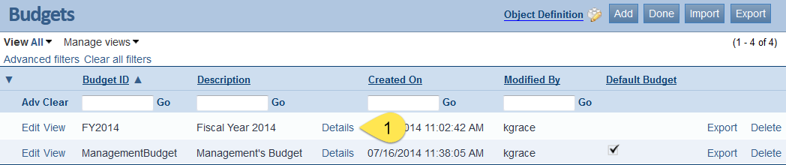
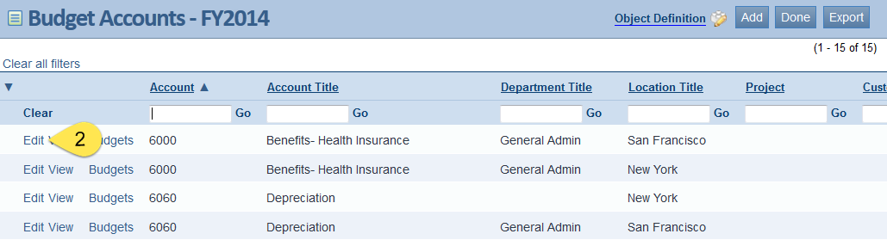
3 – Entering Budget Data (Manual)
General Ledger > Budgets
Notes:
Viewing and managing a list of budgets
Use the Budgets list screen to see a list of the budgets available for selection in financial reports. From this screen, you can create, edit, or view a budget. You can also use this window to import budget data from a spreadsheet, or export data from an existing budget.
Viewing information about a budget
On the row with the account to view, click View. The system displays the Budget Information screen, which shows you the budget ID and a description of the budget.
You can view details about a specific budget account, edit an existing one, or create a new one.

Slide 8
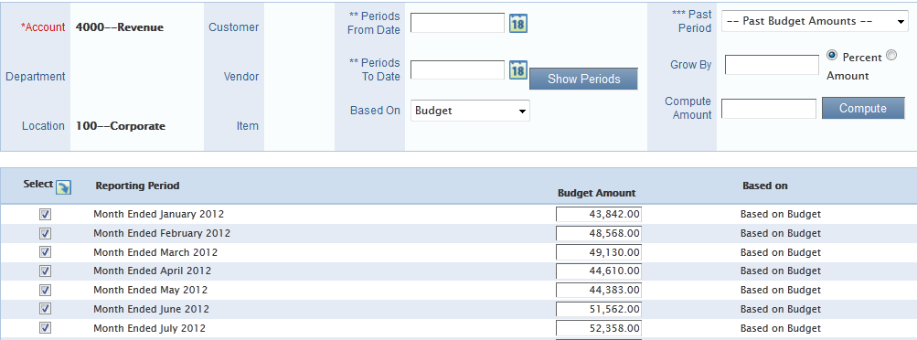
3 – Entering Budget Data (Manual)
Add amounts manually to each period desired

Slide 9
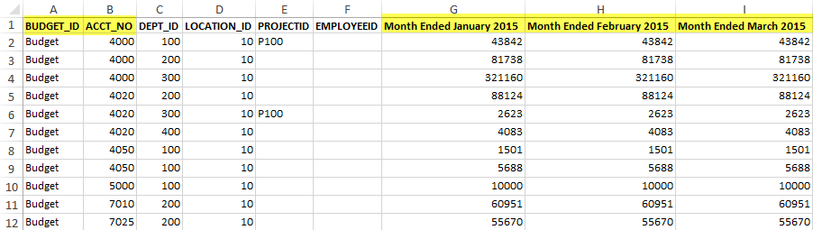
3 – Entering Budget Data (Import)
Budgets can be exported, updated, and re-imported – will over-write!
  Import/Export from Budget list
  When over-writing via import, blank = 0
  Amounts cannot include commas
Notes:
You can find the templates by rolling mouse over “Company”, click on Open Setup, Click on Company Setup Checklist at the top right and then the second section – General Ledger Transactions the last item is the Budgets, Click on the Template to download. Please see Slide 5 on how to name the columns for columns G on. You can add as many Columns you want for your reporting periods. Just make sure that they match “EXACTLY” to what is in your system. You can check this by manually entering a budget line item.

Slide 10
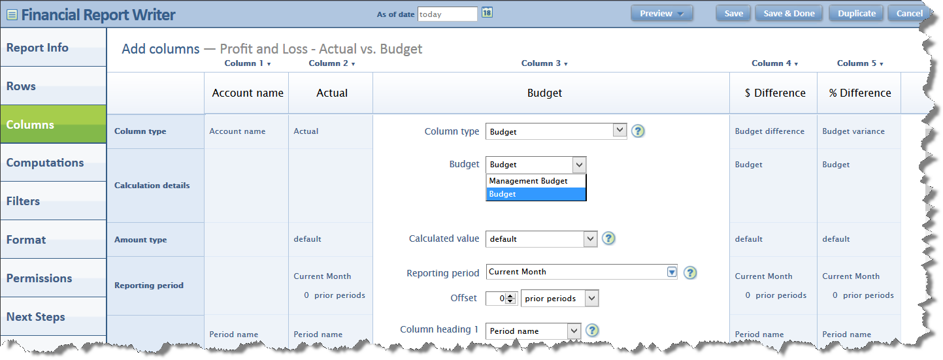
Modify Budget in Existing Financial Reports
From the Report Writer modify each column
Save or Duplicate
Notes:
To review or change the budget for a financial report:
On the Financial Reports list (General Ledger > Financial Reports), click the Edit link next to the name of the financial report you want to review.
On the Columns tab, locate your budget columns.
Review the budget selected in the Budget drop-down menu.
Choose Save to be able to use this report with one budget
Choose Duplicate to create a report that pulls a different budget

Slide 11
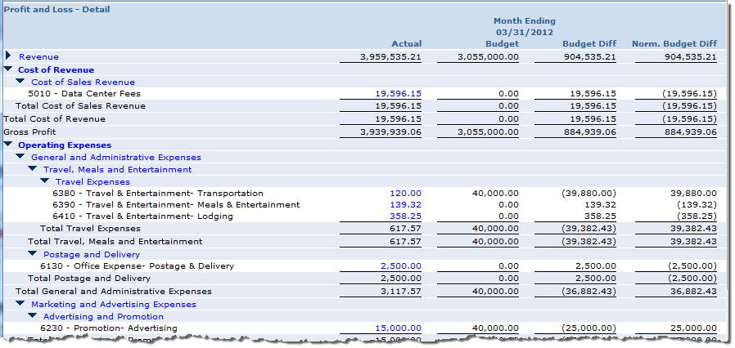
Ex: Actual vs. Budget
Notes:
The example on the slide shows a comparison of actual to budget. For demonstration purposes, the report contains columns for the budgeted amount, the difference between the actual and the budgeted amount and the normalized difference between actual and budgeted amount.
The report is shown with an “As of Date” of 03/31/2012.
Notice the row for Data Center Fees in the Cost of Sales account group.
The actual expense is $19,596.15
The budgeted amount for this expense is $0
For the month of March-2012, more was spent than budgeted for. The difference is $19,596.15
“Budget Diff” shows the difference as positive number since actual – budget yields a positive number. Regular math rules are used to determine the sign.
“Norm. Budget Diff” shows the difference as a negative number since the Data Center Fees account (and the Cost of Sales Revenue account group) have credit normal balance. “Accounting math” rules are applied to determine the sign. This properly shows that the budget was over spent and there is a deficit.

Slide 12
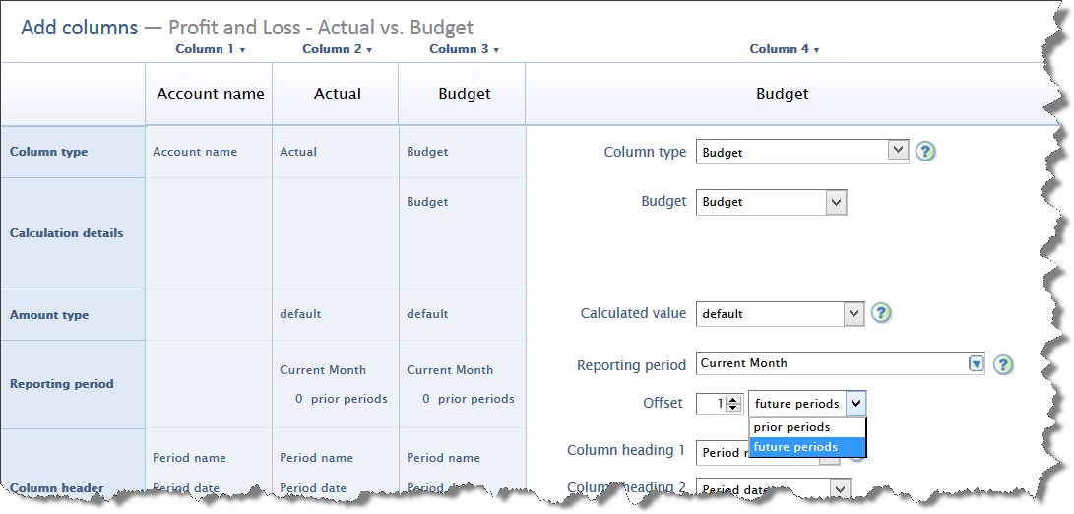
View Budget Data for Future Periods
Use Offset

Slide 13
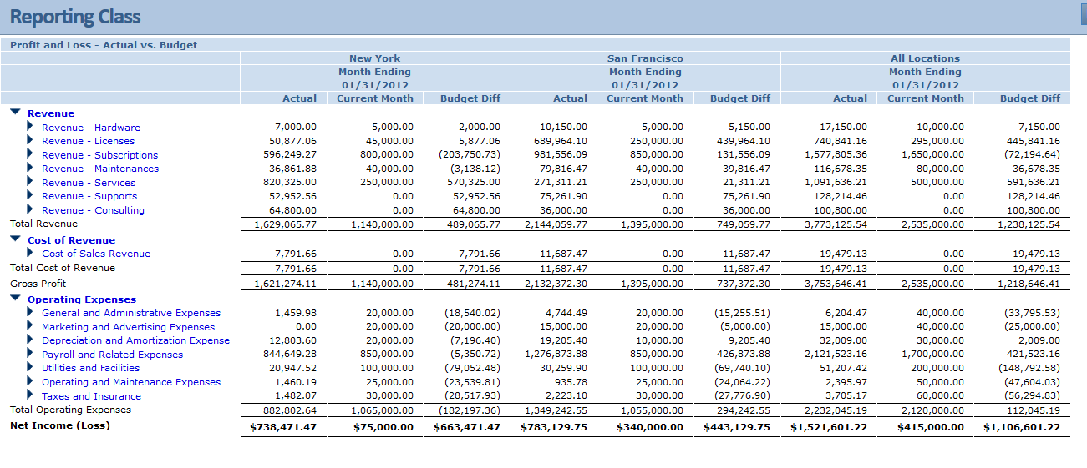
Example of Actual to Budget with the Locations Dimension Expanded

Slide 14
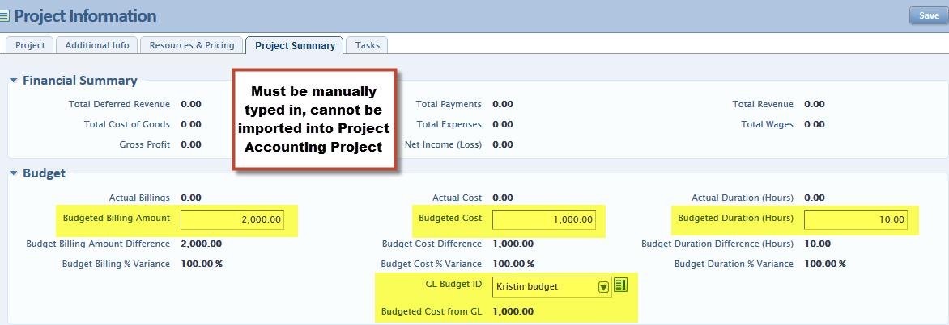
Budget Considerations with Project Accounting
Upload the GL Budget with the project dimension
  Updates the Financial Statements if ran by project
  Can be imported in the GL Budget Template
  Doesn’t transfer to Project Accounting packaged reports
Manually key in budget amounts directly into Project
  Budget amounts are updated within Project Accounting packaged reports
Notes:
We have clients with government contracts where we budget at the project/item/employee level so it agrees to the how the contract was proposed

Slide 15
Budget Considerations with Global Consolidations (IGC)
Create a budget header at the Top Level
  You can select only 1 budget header per consolidation book, in order to get all entities data into a budget, you must create the budget header at Top Level.
Import budget amounts at the Top Level
  The budget amounts are stored for each entity with their respective base currencies by tagging the location dimension
When consolidation is run, it will convert all entities’ budget amounts from their respective base currencies into the consolidated currency

Slide 16
Thank You

